Slide 1
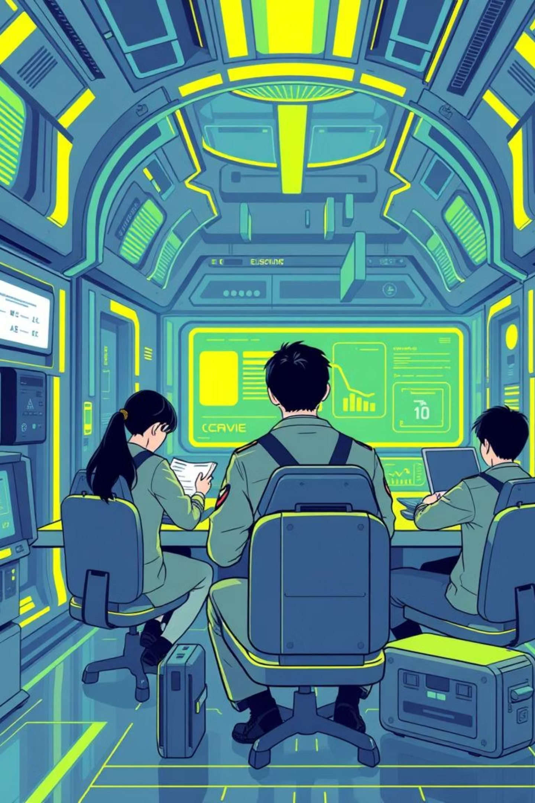
HCI Redesign Presentation - Military Education Portal 🎓

Slide 2
REDESIGNING THE MILITARY EDUCATION PORTAL
Tanta University
Applying Human-Computer Interaction Principles
HCI Course Project
Team Members:
- Ahmed Tamer Al-Nahhal
- Ahmed Beltagy
- Saeed
- Salman

Slide 3
AGENDA
01
02
03
Project Overview & Objectives
Original Website Analysis
Identified HCI Problems
04
05
06
Design Solutions & HCI Principles Applied
Before & After Comparisons
Live Demo
07
Summary & Conclusions

Slide 4
PROJECT OVERVIEW
🎯 OBJECTIVE
🌐 WEBSITE PURPOSE
👥 TARGET USERS
Redesign the Military Education Portal to improve usability and user experience based on HCI principles
Student registration for military education courses
University students (ages 18-25) with varying levels of technical proficiency
Research paper submission
Online examination access
Results inquiry and certificate printing

Slide 5

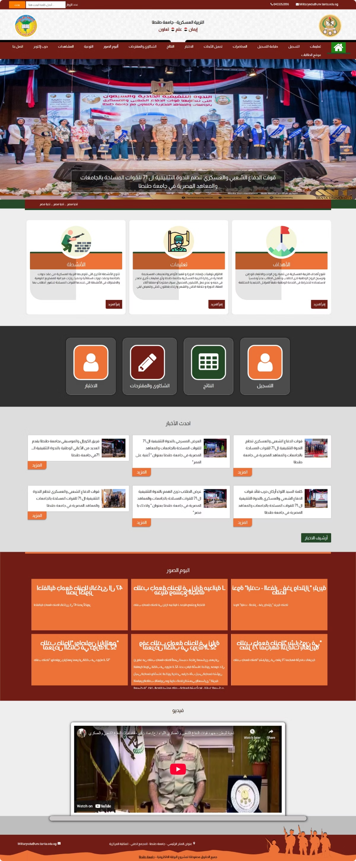
ORIGINAL WEBSITE - HOMEPAGE
FIRST IMPRESSIONS:
❌ Cluttered layout with too much information
❌ Inconsistent color scheme (red, green, orange, brown)
❌ Poor visual hierarchy
❌ Overwhelming navigation with 14+ menu items
❌ Important services hidden among decorative elements

Slide 6
HCI PROBLEM #1: POOR VISIBILITY
📖 HCI PRINCIPLE: VISIBILITY
❌ PROBLEMS IDENTIFIED:
🧠 COGNITIVE IMPACT:
Users experience cognitive overload when trying to identify available actions and their next steps
"Making functions apparent so users know what they can do"
Navigation has 14+ items - exceeds Miller's Law (7±2)
Primary actions (Register, Exam, Results) not prominent
Service icons at bottom of long scrolling page
Important dates buried in content blocks
No clear visual hierarchy to guide user attention

Slide 7
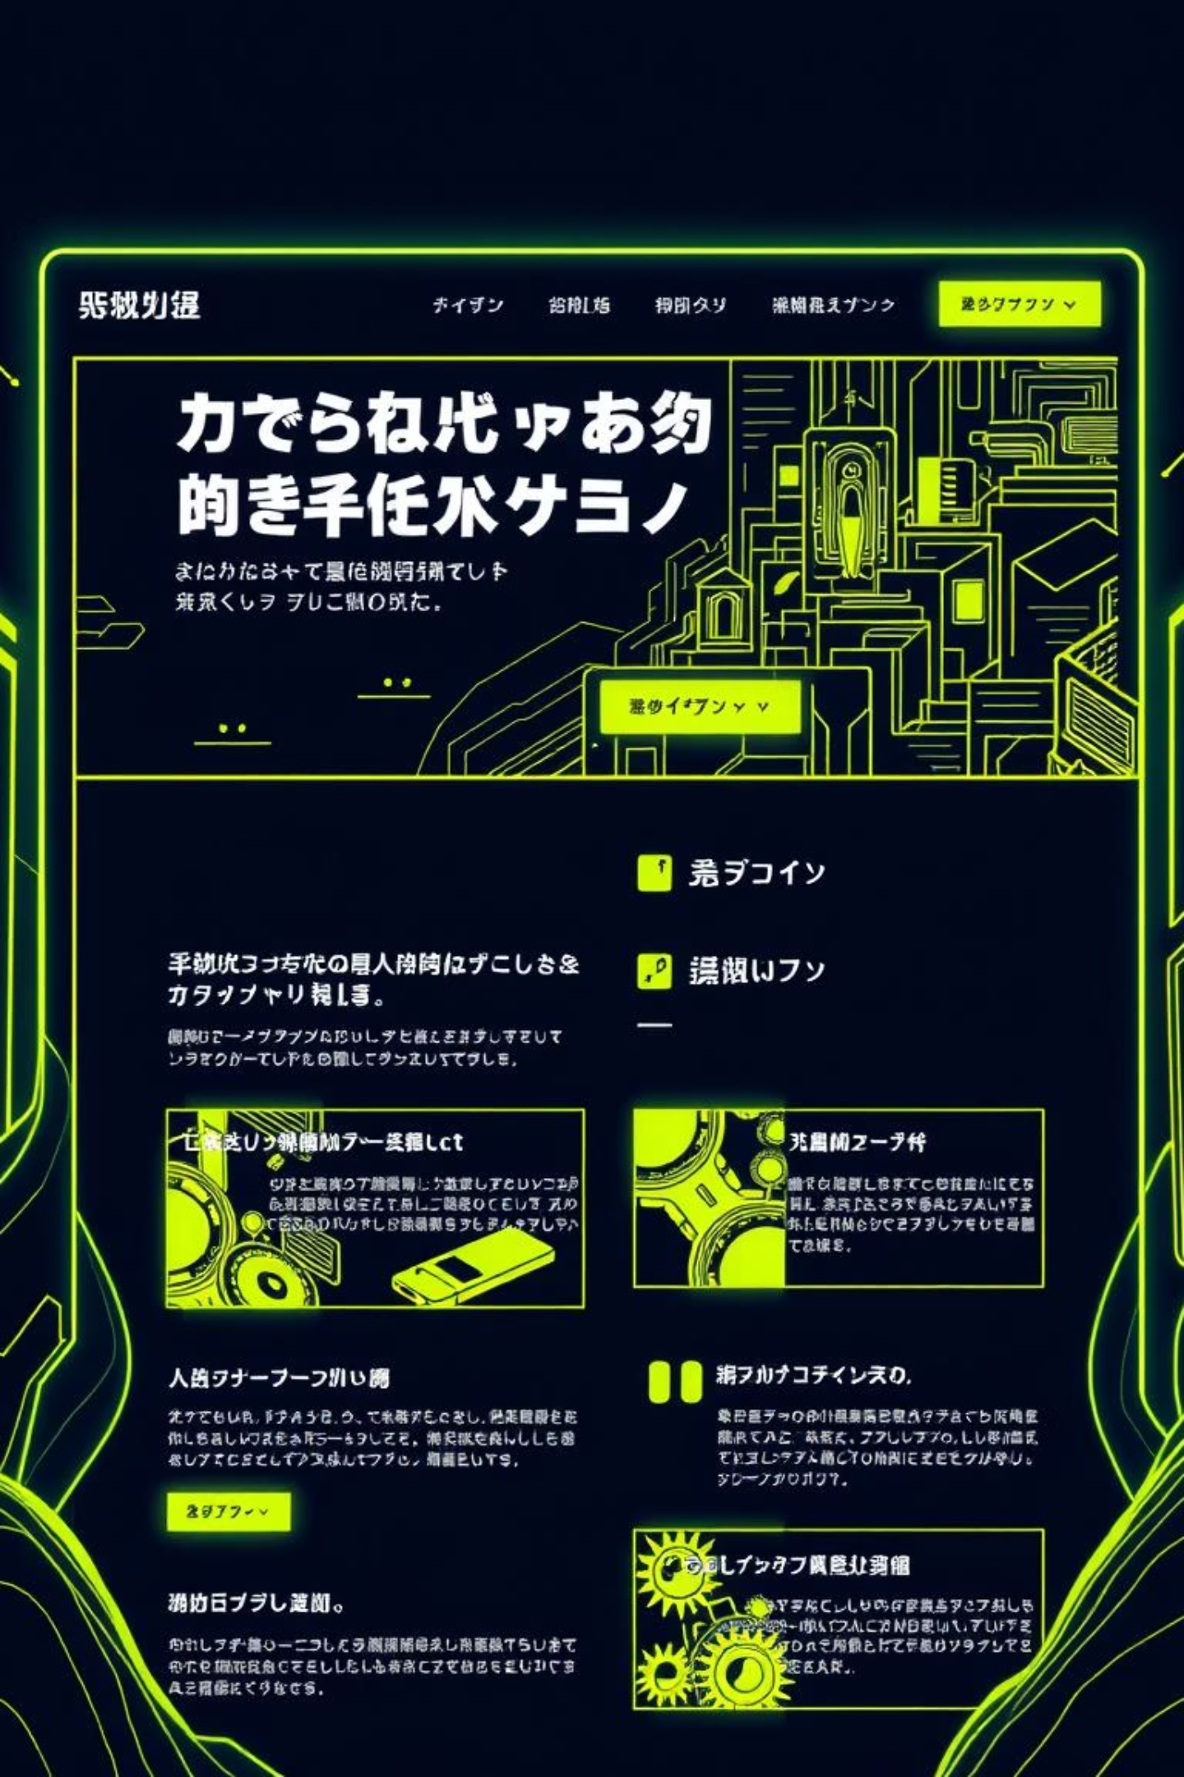
SOLUTION #1: IMPROVED VISIBILITY
✅ IMPROVEMENTS MADE:
Reduced navigation to 6 primary items
Hero section with clear CTAs: "Register Now" & "Check Results"
Services displayed in prominent card slider
Important dates in dedicated highlighted section
Clear visual hierarchy using size, color, and spacing
🎯 RESULT:
Users can immediately identify available actions and understand the interface within seconds

Slide 8

HCI PROBLEM #2: LACK OF FEEDBACK
📖 HCI PRINCIPLE: FEEDBACK
❌ PROBLEMS IN ORIGINAL RESULTS PAGE:
🧠 COGNITIVE IMPACT:
"Sending immediate information back to user about actions performed and accomplishments achieved"
Users feel uncertain and anxious about whether their actions are being processed correctly
No input validation feedback while typing
Empty progress bars with no meaning
No loading indicator during search
No clear success/error messages
User doesn't know if system is processing

Slide 9
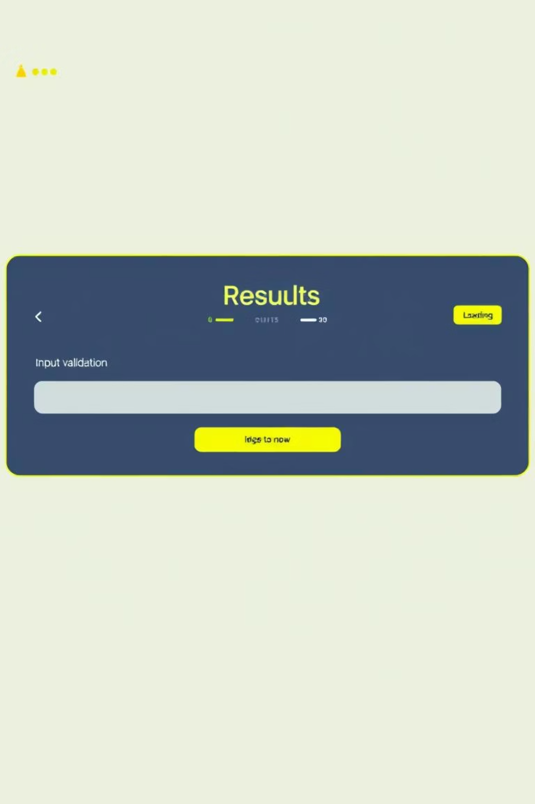
SOLUTION #2: ENHANCED FEEDBACK
✅ FEEDBACK MECHANISMS IMPLEMENTED:
REAL-TIME INPUT VALIDATION
✓ Green checkmark when National ID is valid (14 digits)
✗ Red X when input is invalid
LOADING STATES
Spinner animation during search
Button text changes to "Searching..."
CLEAR RESULT DISPLAY
Success: Green card with student details
Not Found: Red card with helpful suggestions
TOAST NOTIFICATIONS
Animated alerts for errors and confirmations

Slide 10
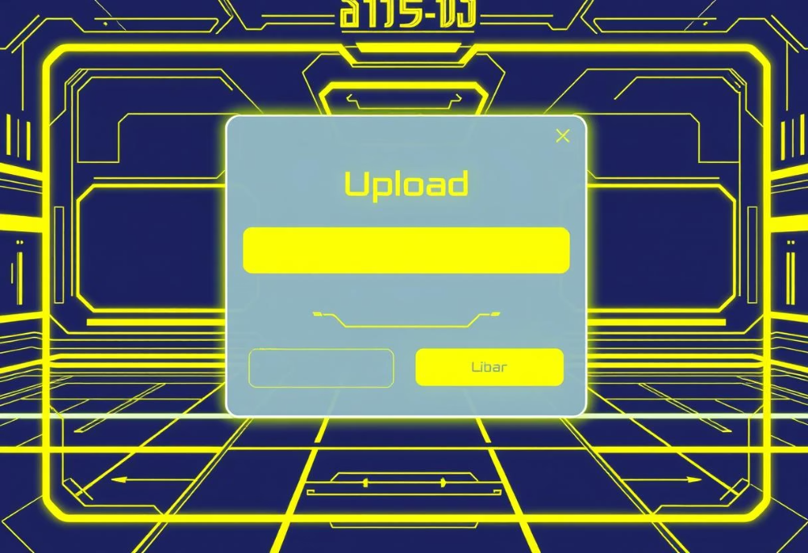
HCI PROBLEM #3: POOR AFFORDANCE
📖 HCI PRINCIPLE: AFFORDANCE
❌ PROBLEMS IN ORIGINAL UPLOAD PAGE:
🧠 USER MENTAL MODEL MISMATCH:
"Properties of an object that suggest how it can be used"
Users expect drag-and-drop for file uploads based on their experience with modern applications
Plain text input for file - no visual "drop zone"
Buttons don't look clickable
No visual indication of what file types are accepted
Form fields blend into background
No clear call-to-action

